Slide 1

Zomato Restaurants Analysis
An in-depth overview of restaurant data across five major Indian cities and five popular cuisines, providing valuable insights for business analysts and product managers.

Slide 2

The ETL Process: Data to Insight
The Extract, Transform, Load (ETL) process is fundamental for preparing raw data for effective analysis and reporting.
Extract
Transform
Load
Gathering raw data from diverse sources such as databases, APIs, and file systems.
Cleaning, filtering, and standardizing data to ensure quality, consistency, and usability.
Delivering refined data into its final destination, ready for business intelligence tools like Power BI.

Slide 3


Project Scope
1
2
3
Total Restaurants Analyzed
Diverse Cuisines Explored
Key Cities Covered
An examination of 5 popular global cuisines: American, Chinese, Indian, Italian, and Mexican.
Analysis spanning 5 major Indian metropolitan areas: Bangalore, Chennai, Delhi, Hyderabad, and Mumbai.
A comprehensive dataset covering 100 unique restaurant establishments.

Slide 4
City-wise Restaurant Distribution
Chennai: 22 Restaurants
Delhi: 22 Restaurants
Hyderabad: 22 Restaurants
A significant presence, indicating strong market penetration and customer base.
Equally strong as Chennai, highlighting its importance as a culinary hub.
Consistent with other leading cities, showcasing growth potential.
Bangalore: 17 Restaurants
Mumbai: 17 Restaurants
A healthy number, suggesting opportunities for further expansion.
Similar to Bangalore, an important market with room for strategic growth.

Slide 5





Cuisine-wise Restaurant Distribution
Chinese: 25 Restaurants
Leading the pack, indicating high consumer demand and market saturation.
Indian: 21 Restaurants
A strong second, showcasing the enduring popularity of local flavors.
American: 20 Restaurants
A consistent performer, appealing to a broad demographic.
Italian: 17 Restaurants
A significant presence, demonstrating its appeal in the market.
Mexican: 17 Restaurants
An emerging cuisine with dedicated followers, matching Italian in number.

Slide 6
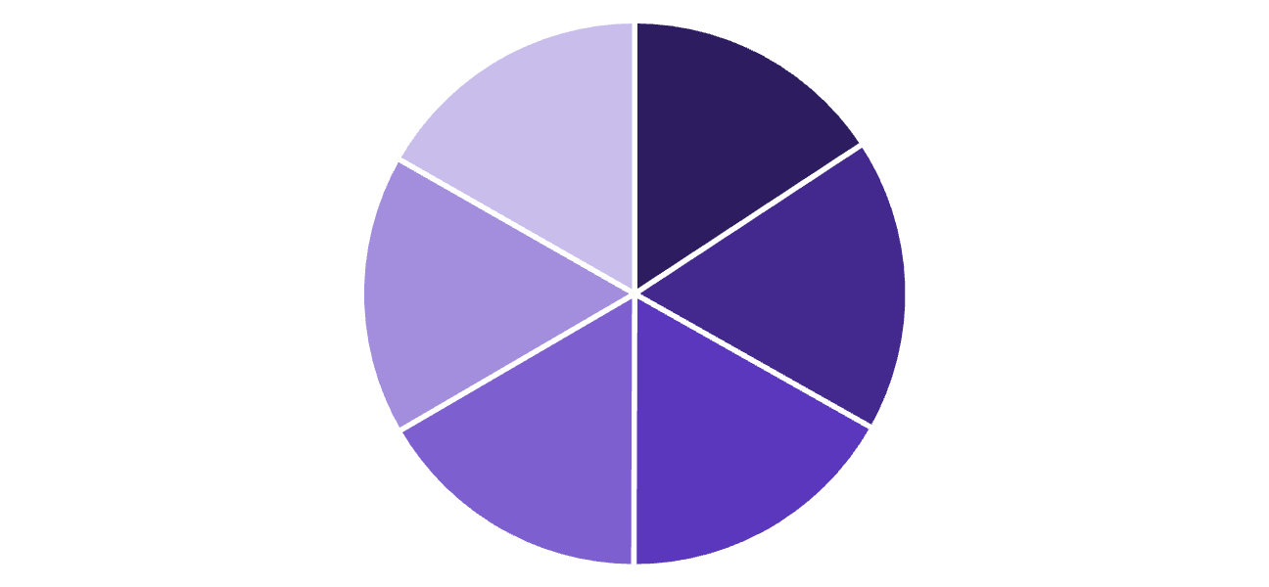
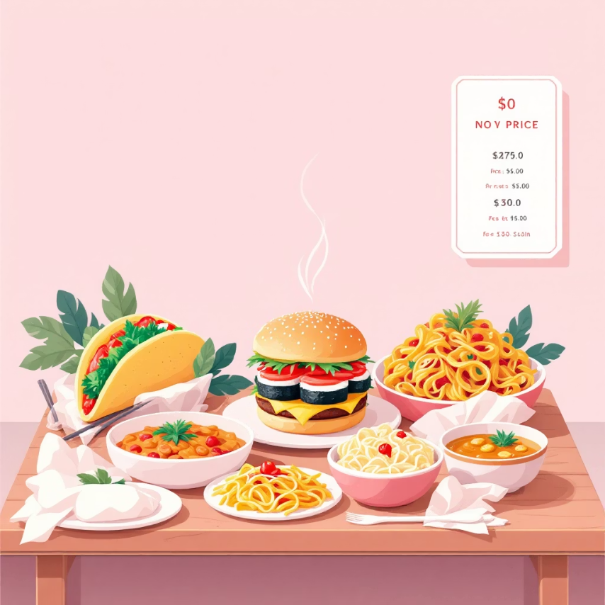
Item Price Analysis
Average Item Prices by Popular Dishes
Understanding the pricing strategy for various menu items is crucial for optimizing profitability and competitiveness.
Sushi leads with the highest average price at ₹888.
Burger and Curry maintain competitive pricing around ₹850.
Taco and Pasta are positioned at slightly lower price points, attracting value-conscious customers.
Taco
Sushi
Burger
Pasta
Curry
Others

Slide 7
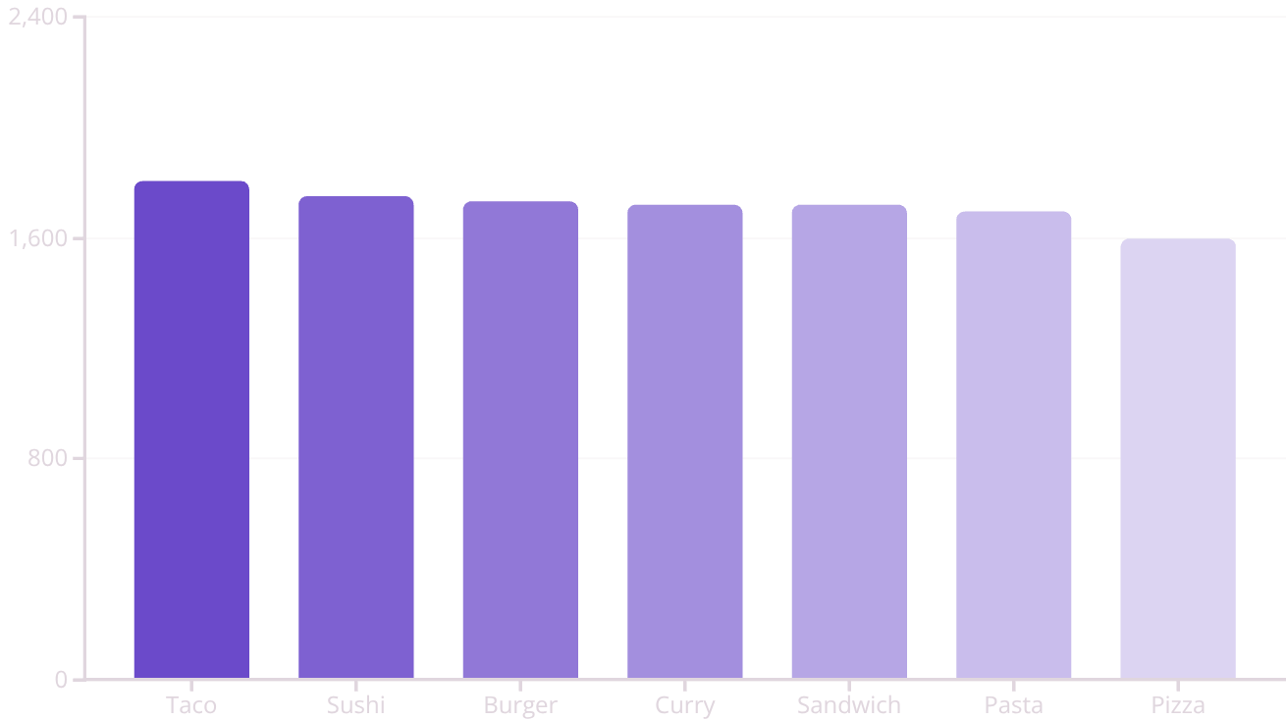
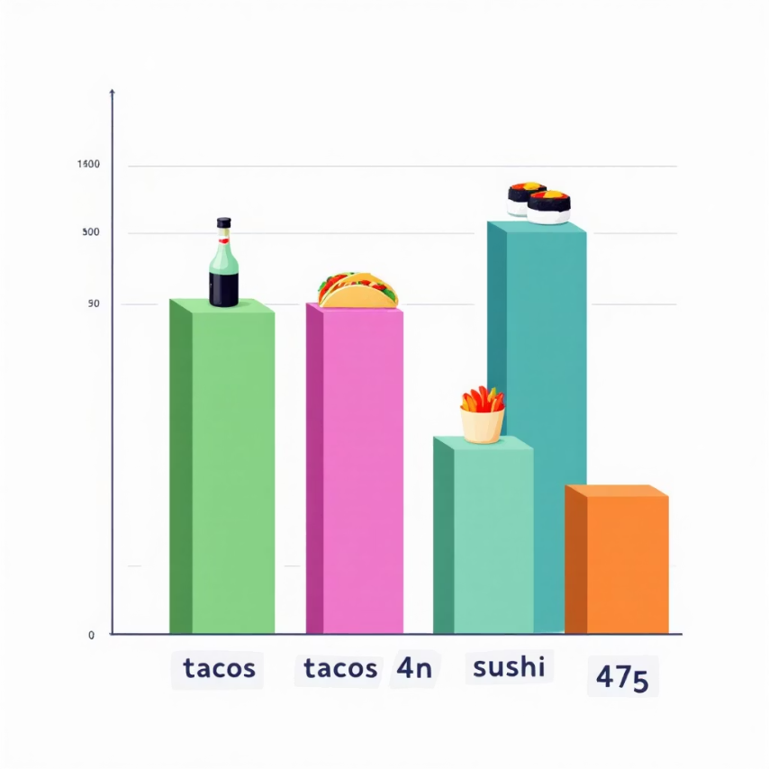
Item Quantity Analysis
Top-Selling Items by Quantity
This bar chart highlights the most frequently ordered items, offering critical insights for inventory management and menu planning.
Taco leads in sales volume with 1804 units, making it a star performer.
Sushi and Burger closely follow, demonstrating consistent high demand.
Items like Curry, Sandwich, Pasta, and Pizza also contribute significantly to overall sales.

Slide 8
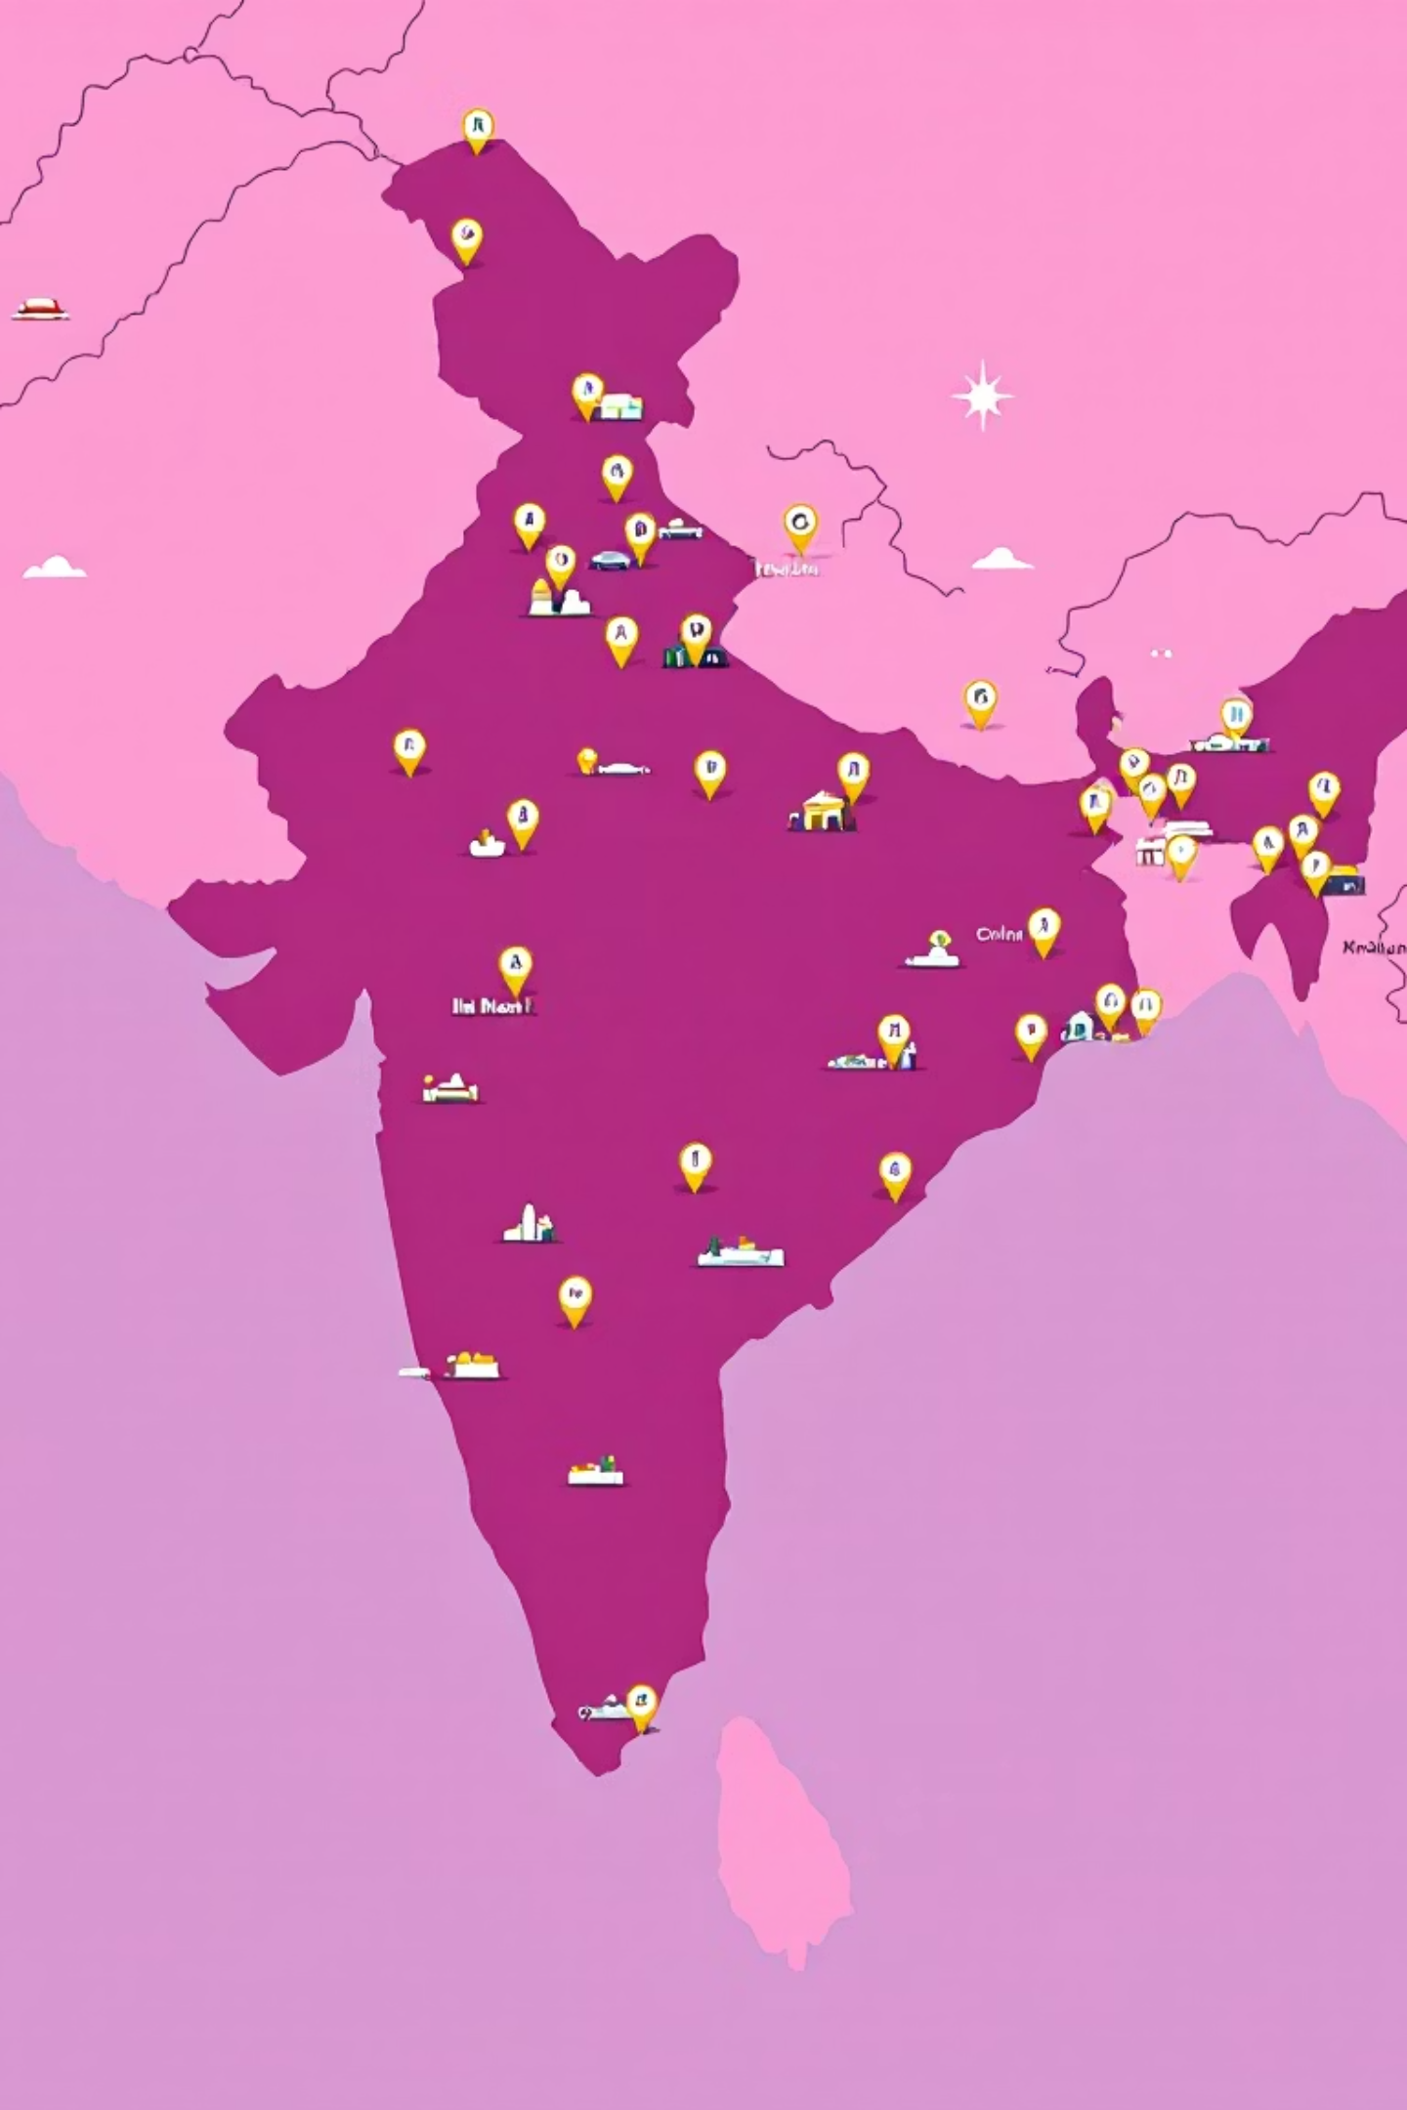



Geographic Distribution
Bengaluru
Chennai
Restaurant cluster and urban demand
Coastal market with steady traffic
Delhi
Mumbai
High-density metro coverage
Key commercial and dining hub
A visual representation of our restaurant network, showcasing geographical spread and potential areas for market expansion. This map helps identify clusters and gaps in our coverage.

Slide 9




Key Insights and Recommendations
Top-Selling Items Identified
Taco, Sushi, and Burger are consistently performing as our highest-selling menu items. Prioritize these for promotions and quality control.
Chinese Cuisine Dominance
Chinese cuisine holds the largest share of restaurants and customer interest. Capitalize on this popularity with targeted campaigns and diverse offerings.
High-Density Cities
Chennai, Delhi, and Hyderabad boast the highest restaurant counts. These cities represent established markets with significant growth potential.
Strategic Marketing Focus
Direct marketing efforts and resource allocation towards our top-performing cities and most popular cuisines to maximize ROI and market share.

Slide 10

Conclusion
Strong Presence
Zomato enjoys a robust foothold in Chennai, Delhi, and Hyderabad, forming a solid base for further expansion.
Cuisine Leadership
Chinese cuisine is a clear leader in popularity, indicating a high demand that can be leveraged for menu innovation and restaurant partnerships.
Top Performers
Taco and Sushi stand out as top-selling items, providing valuable data for procurement, promotions, and menu feature planning.
Strategic Optimization
By utilizing these insights, we can fine-tune menu offerings and tailor city-specific strategies to enhance customer satisfaction and drive business growth.

